Slide 1
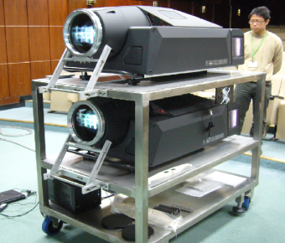
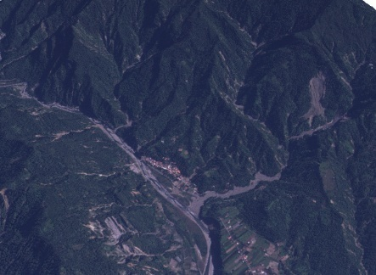
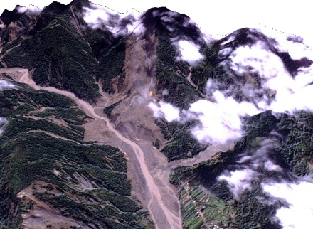
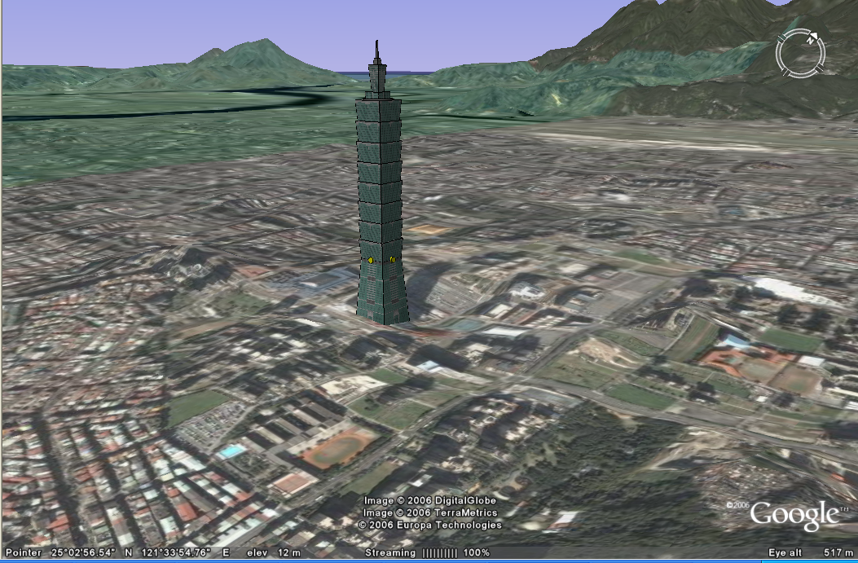
PRAGMA 22 Melbourne, Australia
Taiwan
3D GIS Taiwan on Cloud
Whey-Fone Tsai & Fang-Pang Lin National Center for High-performance Computing
National Applied Research Laboratories
Hsinchu, Taiwan
April 19, 2011

Slide 2
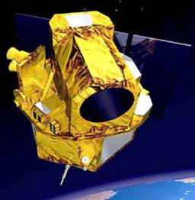
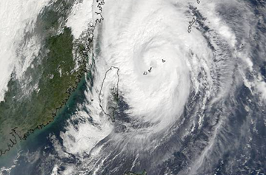
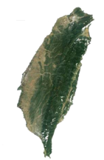
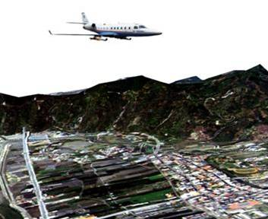
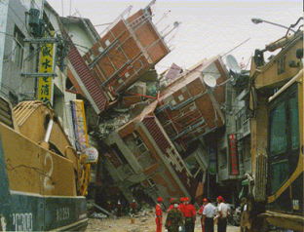
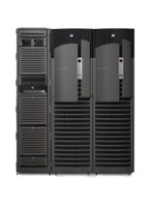
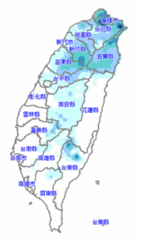
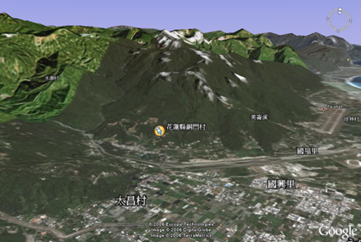
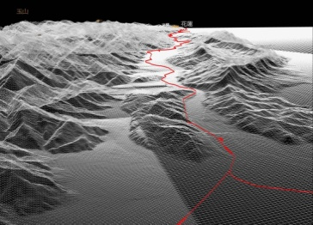
3D GIS Taiwan Platform A Multidisciplinary Research under NARL, to Support for Natural Disaster Response & Recovery
Observation & Platform
Simulations & Applications
NSPO: Remote Sensing Image
TTFRI: Typhoon & Flood Research
ITRC: Optical Airborne Image
NCREE: Earthquake Engineering
NARL
Synergy on Environmental & Disaster Prevention
NCHC: Data Warehouse HPC & 3D Visualization
NCDR: Disaster Reduction Technology

Slide 3
Demand of Images versus Time after Disaster Occurred
Real-time disaster information
Near real-time disaster information
High-resolution, 3D disaster information
First View of
Disaster Scenario
Damage Loss &
Deployment
Evaluation
Recovery Planning of Disaster Areas
Easy & Quick Assessment
Preliminary Assessment
Detailed Assessment
Image Resource:
‧ Helicopter
‧ Monitoring camera
& sensors
Image Resource:
‧Satellite
‧Helicopter
‧UAV
Image Resource:
‧Satellite
‧Airborne image
‧UAV ‧in situ-3D photo
Initial stage Evacuation & Rescue stage
Response phase
Time
Mitigation and Recovery Phase

Slide 4
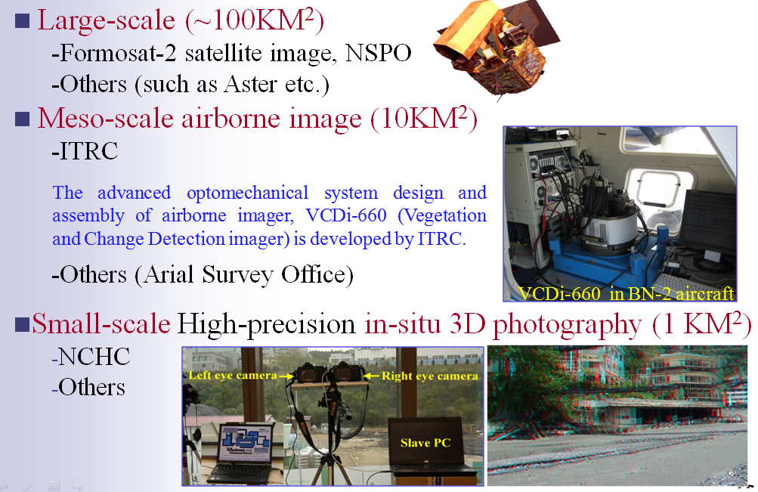
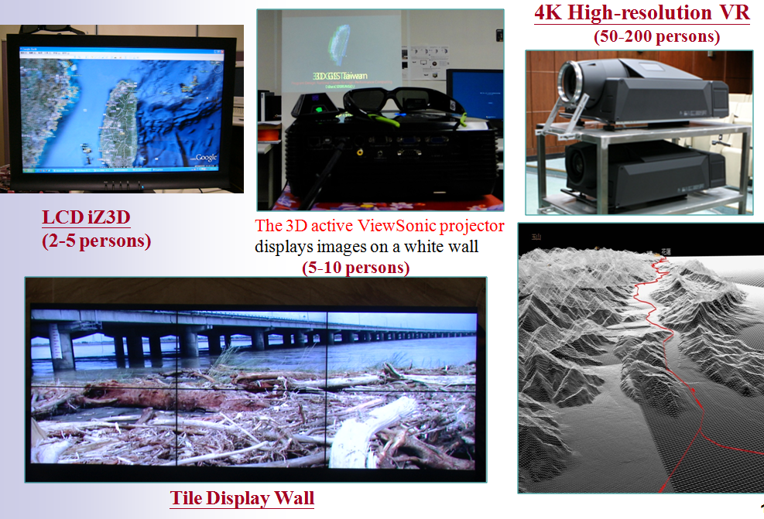
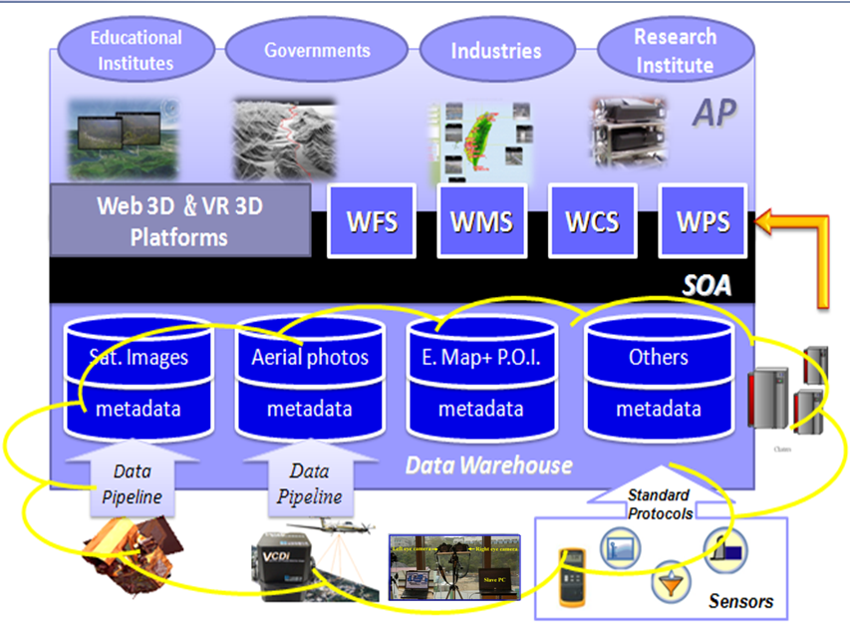
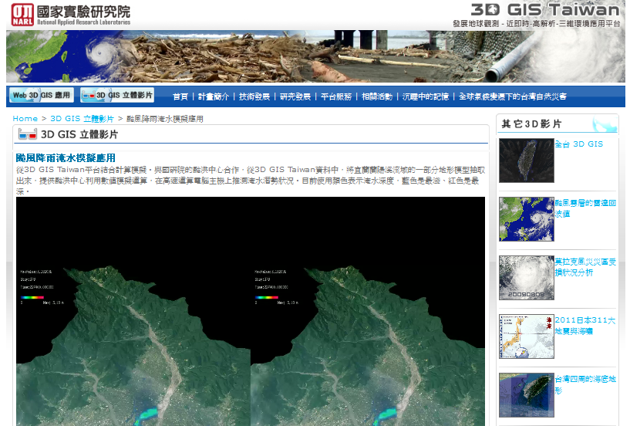
3D GIS Taiwan Platform: Developments
Multi-scale Observation
3D GIS Visualization
Data Warehouse & Cloud Connectivity
3D GIS Stereo Display Cloud Service
OGC Standard

Slide 5
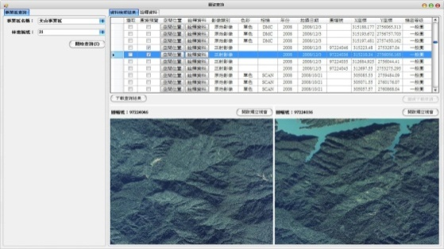

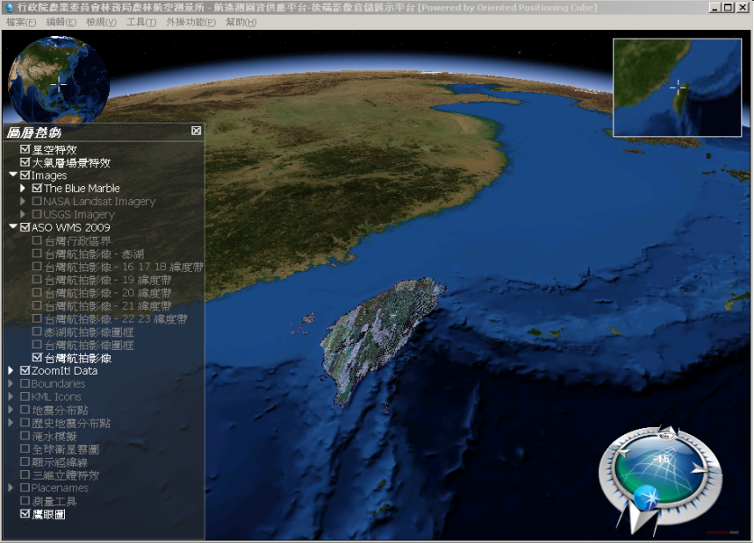
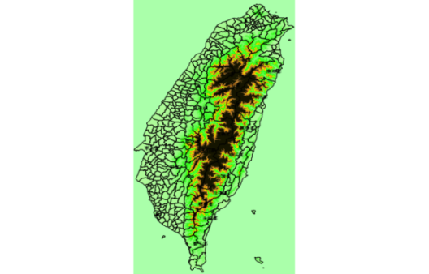

Web 3D GIS System & Web Map Service Cloud
Web 3D GIS System World Wind Taiwan
Images Stitching or Overlaying
Image Server(2V ) -NCHC
Internet
WMS Metadata Server(1) -NCHC
Storage Server
Web Map Service Cloud
2012
WMS Server(1) – NSPO/NCU
WMS Server(1)-NCDR
DEM Server(2V) -NCHC

Slide 6
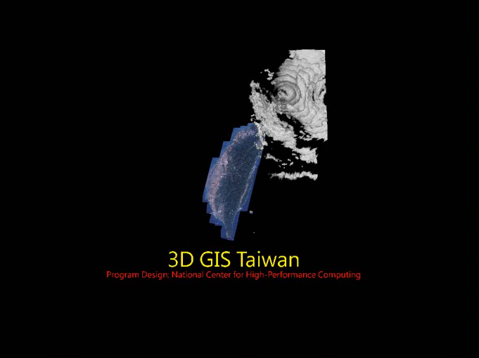
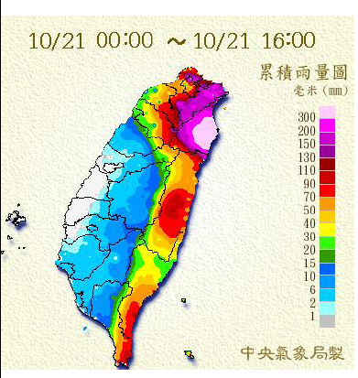
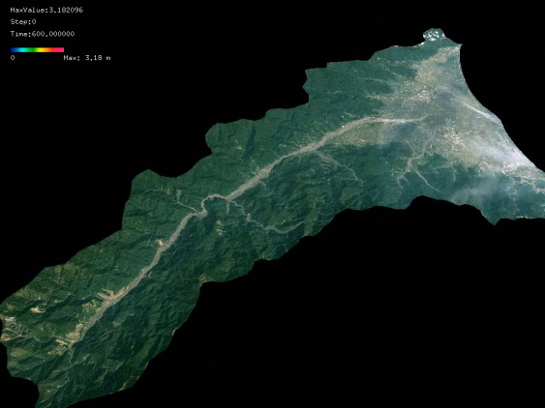
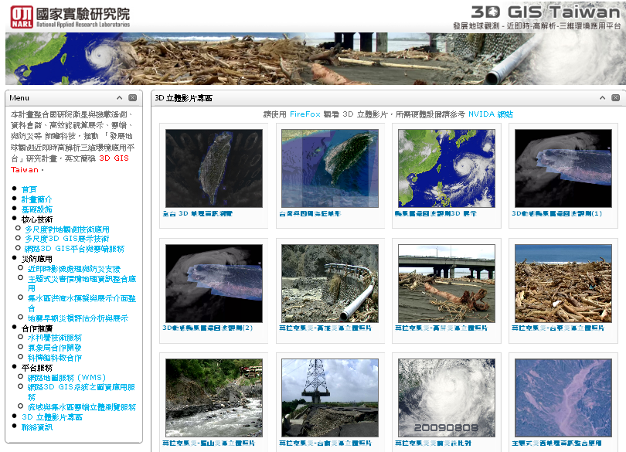
Implementation Processes of 3D GIS Stereo Display in Web
Model Simulation Output
Observation
Data processing into stereo image
Overlaid with 3D GIS terrain
Precipitation
Atmospheric & Hydrological Model
3D Cloud: Radar Return Wave Observation
Convert to 3D Vision adaptable stereo video
Upload to 3D GIS Taiwan Web server for cloud service

Slide 7
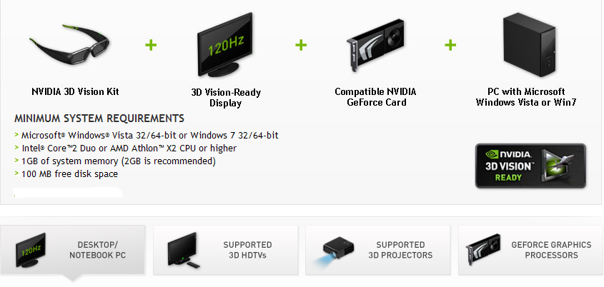
nVIDIA 3D Vision System Requirements
Navigation of 3D GIS Stereo Video in Web: Requirement
WebM (HTML5)+ Firefox version 4 and above
WebM is an audio-video format designed to provide royalty-free, open video compression for use with HTML5 video

Slide 8
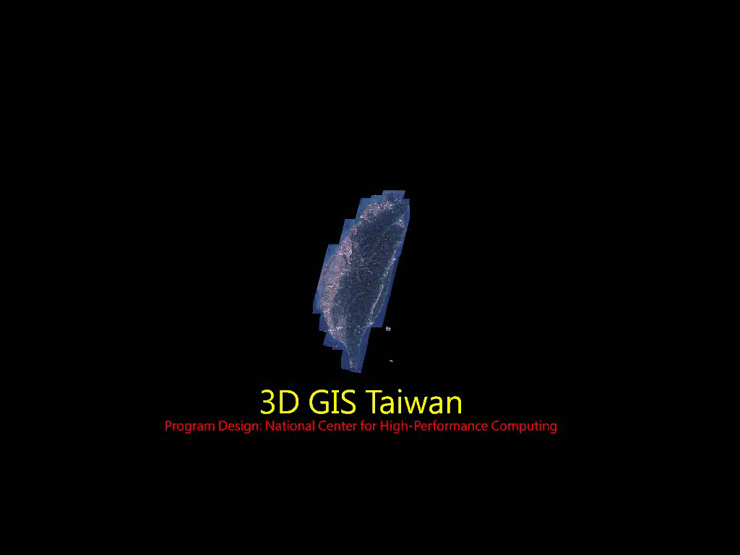
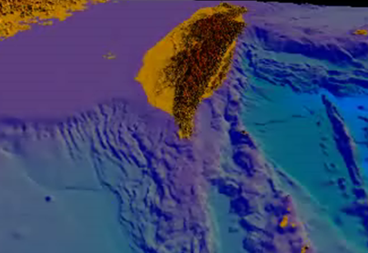
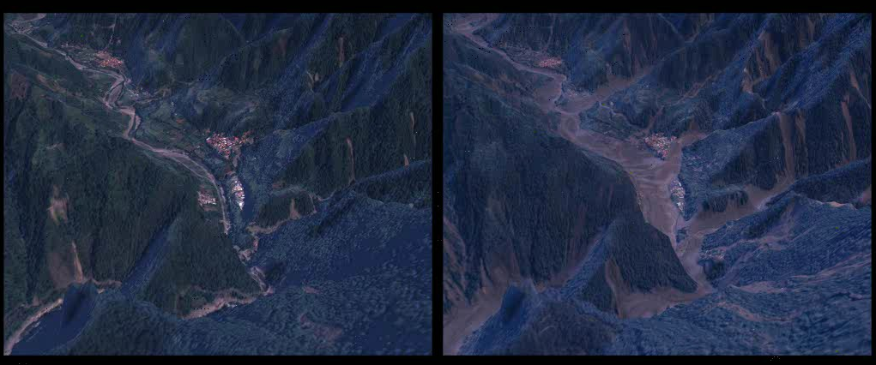
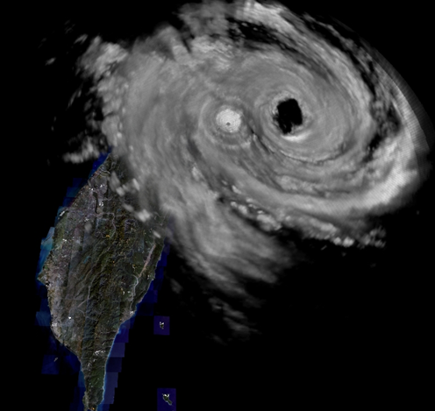
Applications in Natural Disaster Management
3D Image and Terrain in Whole Taiwan
3D Seabed Geographical Terrain
Before
After
Typhoon Morokot in Shiaolin Village
3D Cloud: Radar Return Wave

Slide 9
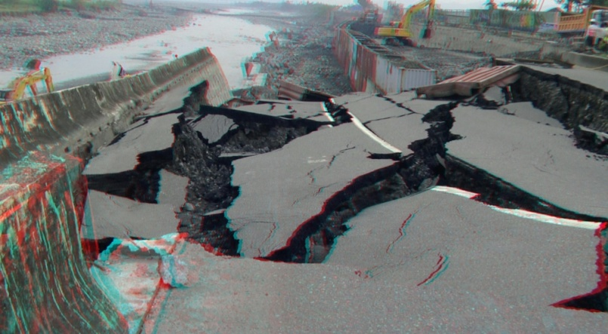
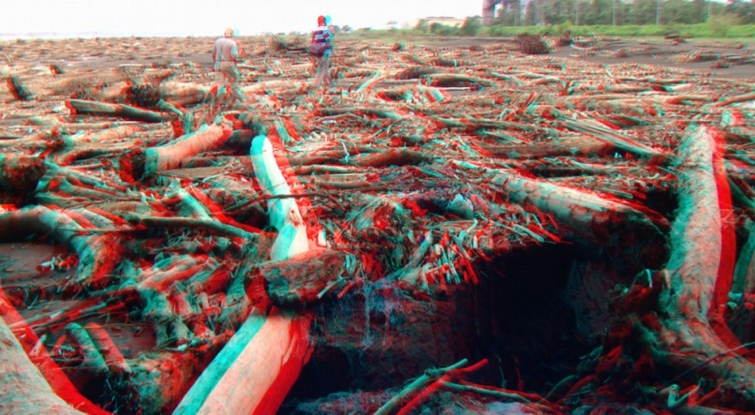
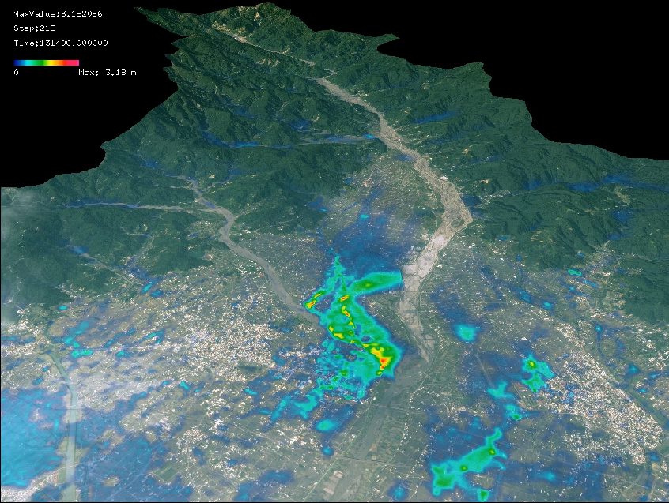
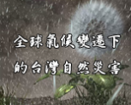
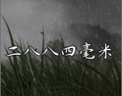
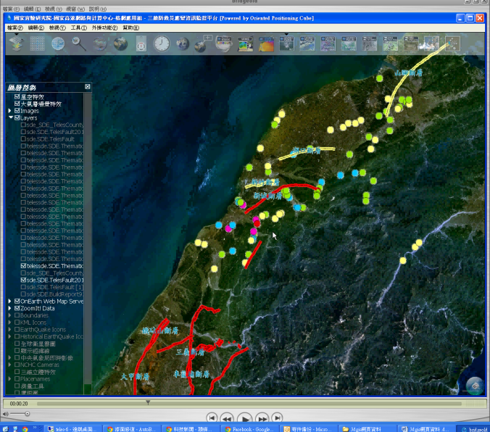
Applications in Natural Disaster Decision Support
Typhoon Morakot Induced damage
Typhoon Morakot Induced damage
Flood & Inundation
3D Seabed Geographical Terrain
Earthquake Damage & Loss Estimation
Disaster due to Climate Change
2884 mm: Typhoon Morakot
3D Cloud: Radar Return Wave

Slide 10
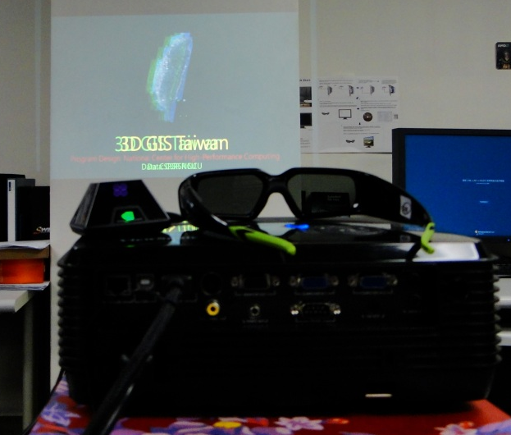

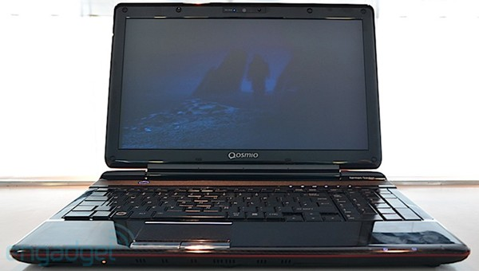
3D Stereo Display Systems
At NCHC, we have…..
Viewsonic glasses-required 3D projector
Dell XPS 17 glasses-required 3D laptop
Toshiba Qosmio F750 glasses-free 3D laptop

Slide 11
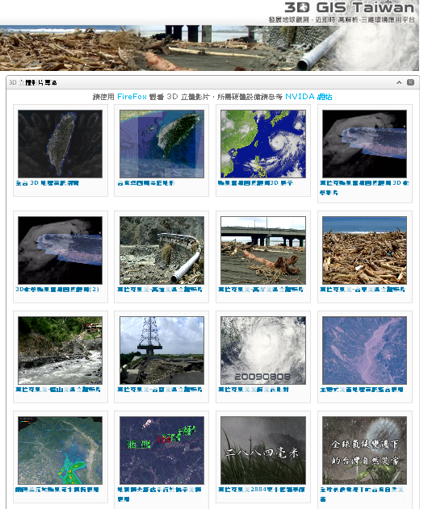
LIFE DEMO
http//3dgis.colife.org.tw
Toshiba Qosmio F750 glasses-free 3D laptop
Firefox 4.0 and above

Slide 12
Concluding Remarks
Unique disaster decision support approach through the use 3D GIS Stereo Display Cloud service.
Vertical integration of data, platform, model, and service through integration of Iaas, Paas, and Saas cloud layers.
It will be used by Taiwan government for disaster management officially.

Slide 13
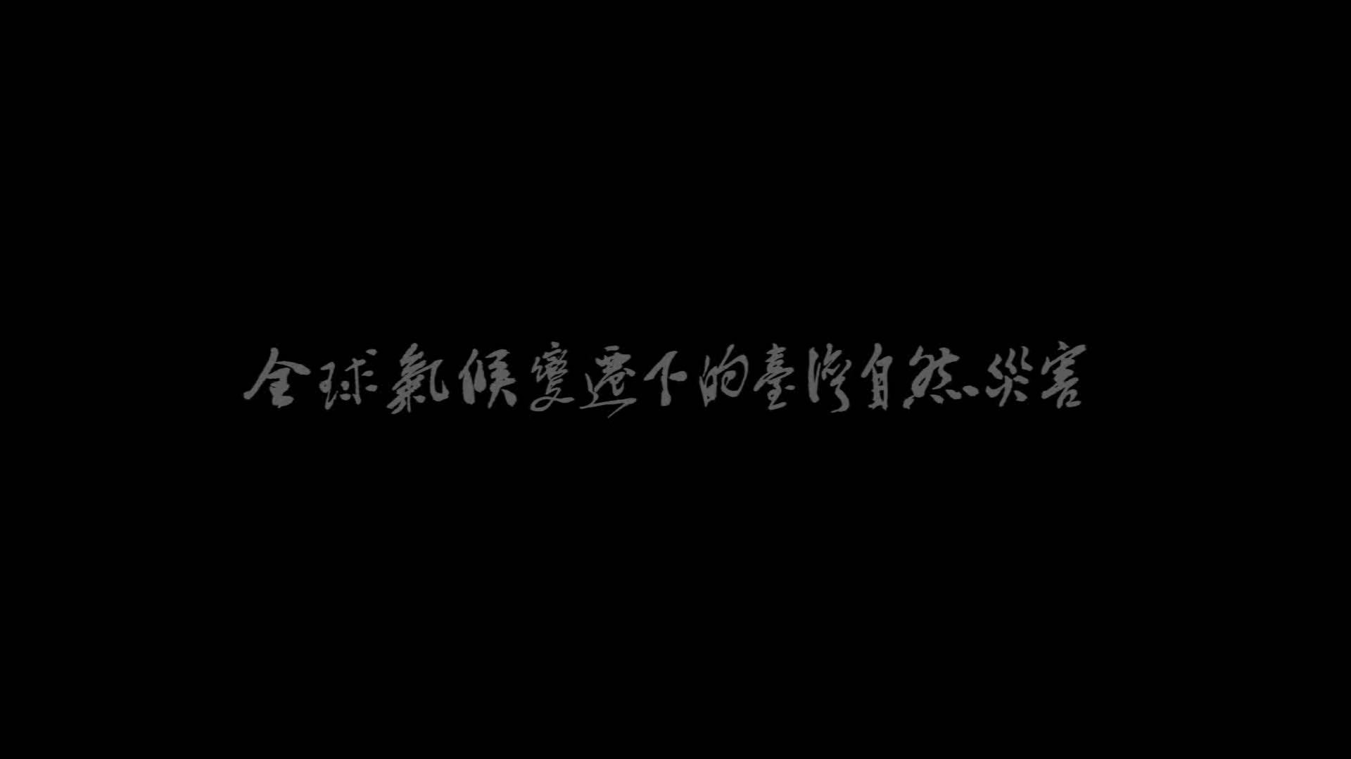

Slide 14
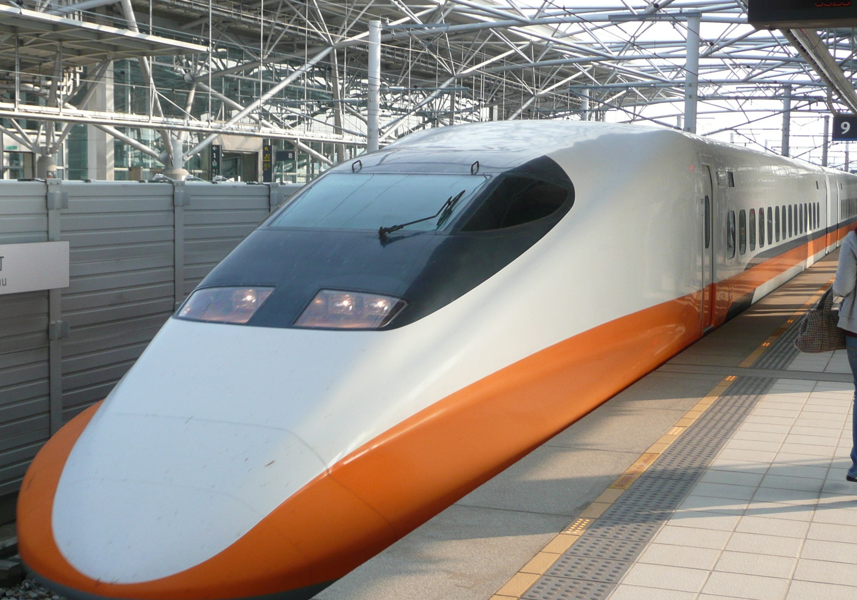
3D GIS Taiwan
Thank you

